Slide 1
Unit-4:
Basis Path Testing

Slide 2
Path Meaning:
Code-based testing methods are very responsive to rigorous definitions, mathematical analysis, and useful measurement.
If from the very first statement the flow of control taken till it concludes or finishes a specific objective based on specific decision, named as PATH.
The word path can also be termed indirectly as graph as the we can plot different paths for the same program based on the decision it flows.
Using these paths also we can device test cases for the software testing, which is known as path testing.
These path testing further classified into 2 types. Known as 1) Program Graph 2) Decision-to-Decision path

Slide 3
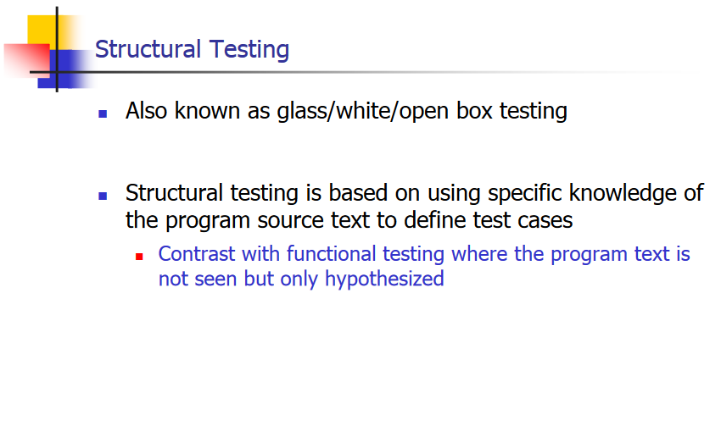

Slide 4
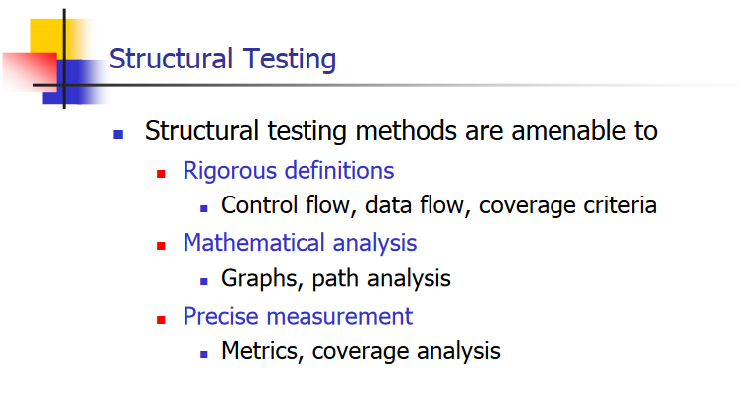

Slide 5
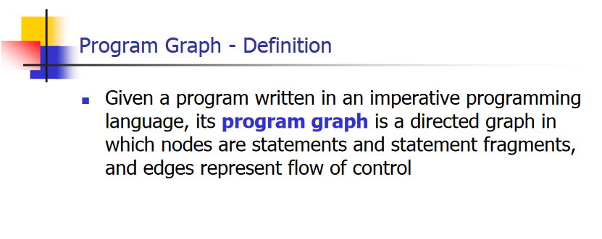

Slide 6
Definition
Given a program written in an imperative programming language, program graph is a directed graph in which nodes are statement fragments, and edges represent flow of control.
A complete statement is a “default” statement fragment.
If i and j are nodes in the program graph, an edge exists from node i to node j if and only if the statement fragment corresponding to node j can be executed immediately after the statement fragment corresponding to node i.

Slide 7
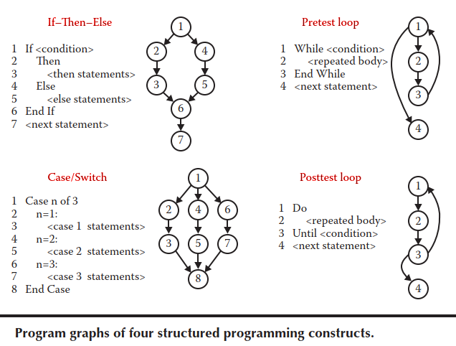

Slide 8
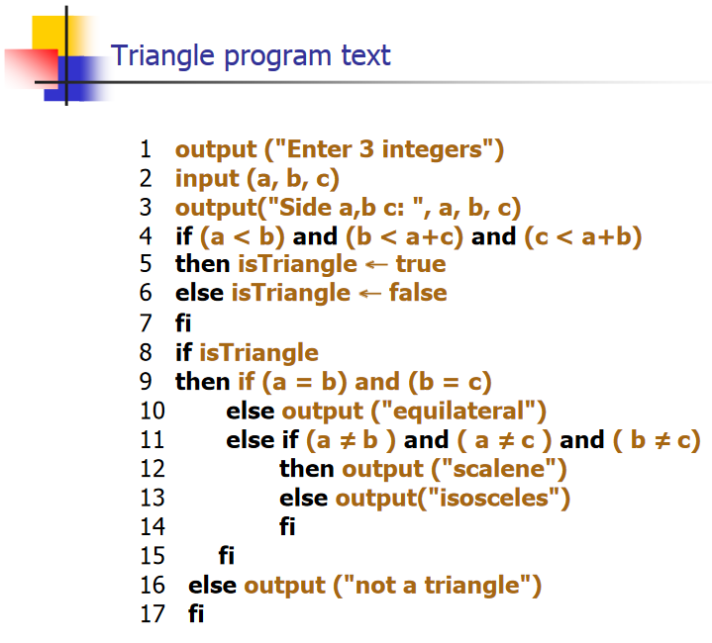

Slide 9
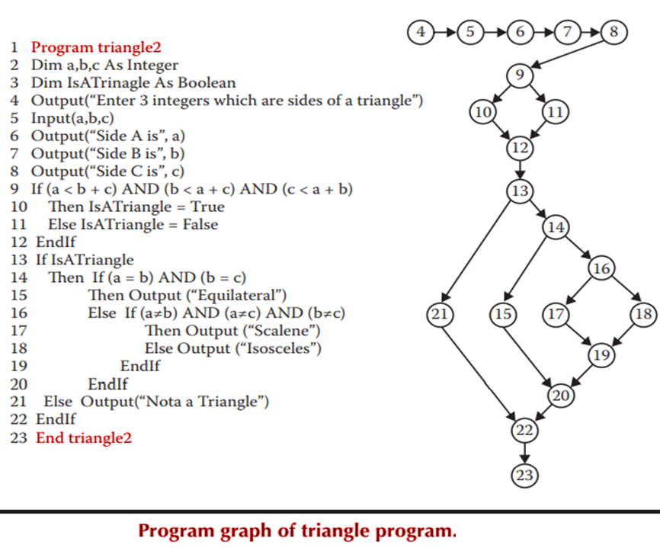

Slide 10
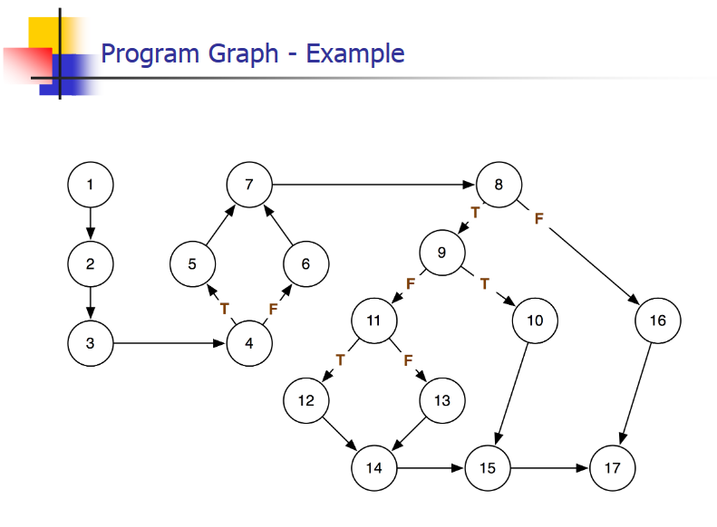

Slide 11
DD-paths
(Decision-to-Decision)
The best-known form of code-based testing is based on a construct known as a decision-to-decision path (DD-path) (Miller, 1977).
The name refers to a sequence of statements that, in Miller’s words, begins with the “outway” of a decision statement and ends with the “inway” of the next decision statement.
No internal branches occur in such a sequence

Slide 12
Definition
DD-paths in terms of paths of nodes in a program graph.
In graph theory, these paths are called chains, where a chain is a path in which the initial and terminal nodes are distinct, and every interior node has indegree(indeg)=1 and outdegree(outdeg) = 1 in a connected graph.
Important to note that the initial node is 2-connected to every other node in the chain, and no instances of 1- or 3-connected nodes occur.

Slide 13
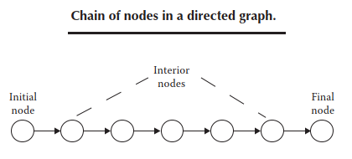

Slide 14
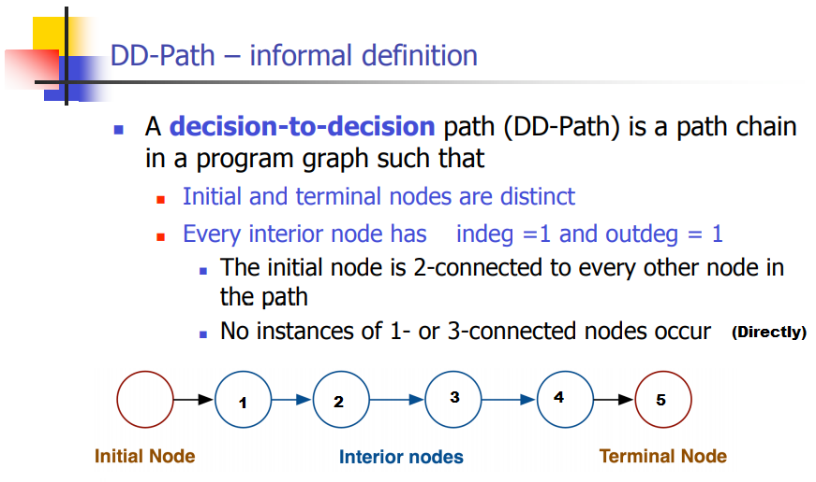

Slide 15
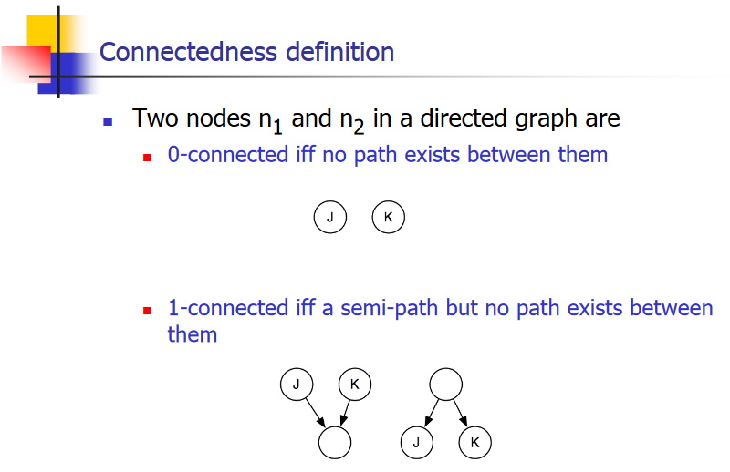

Slide 16
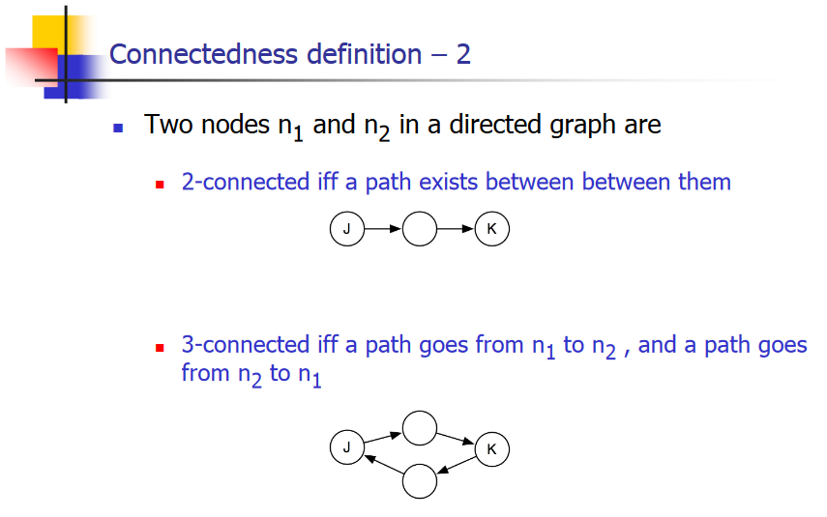

Slide 17
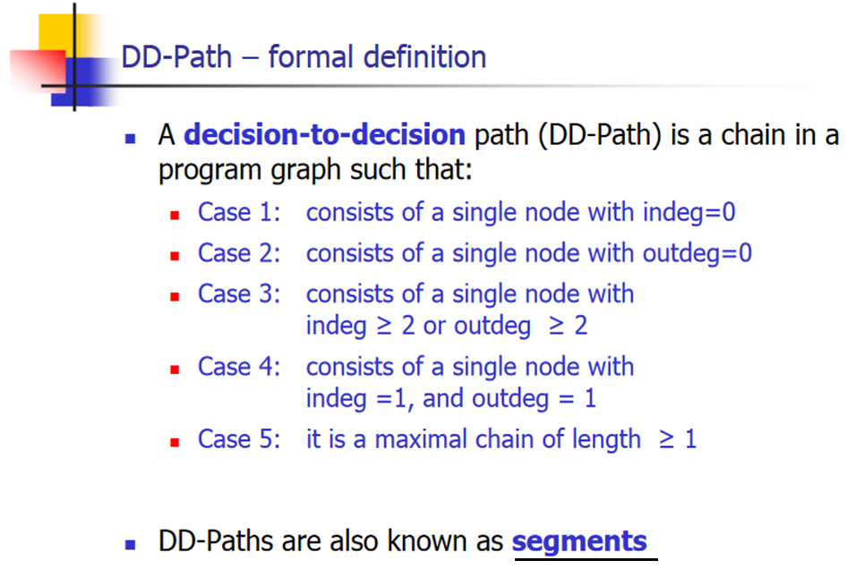

Slide 18
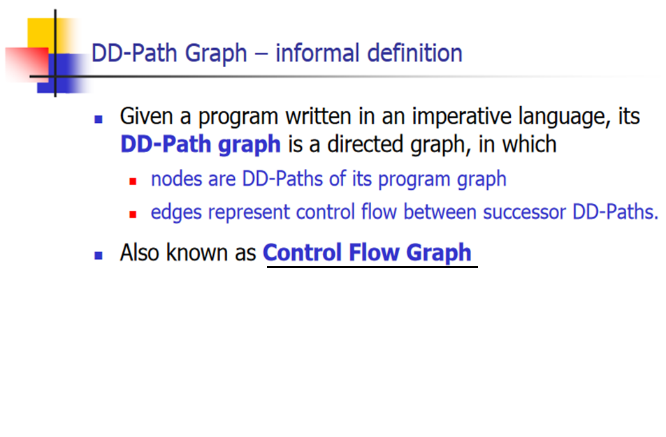

Slide 19
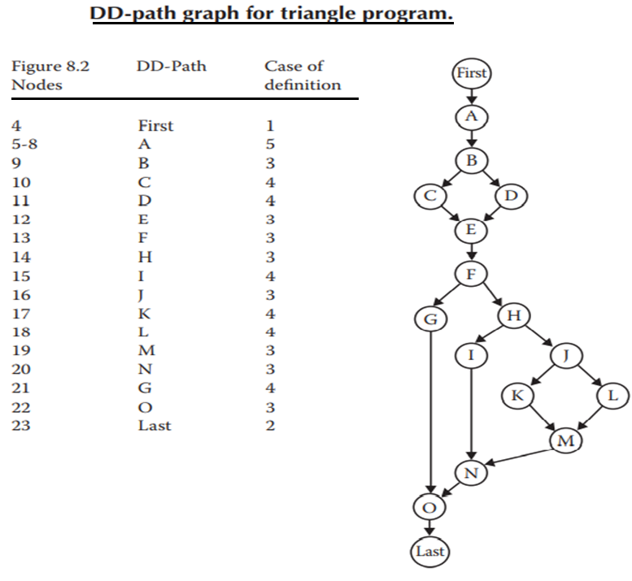

Slide 20
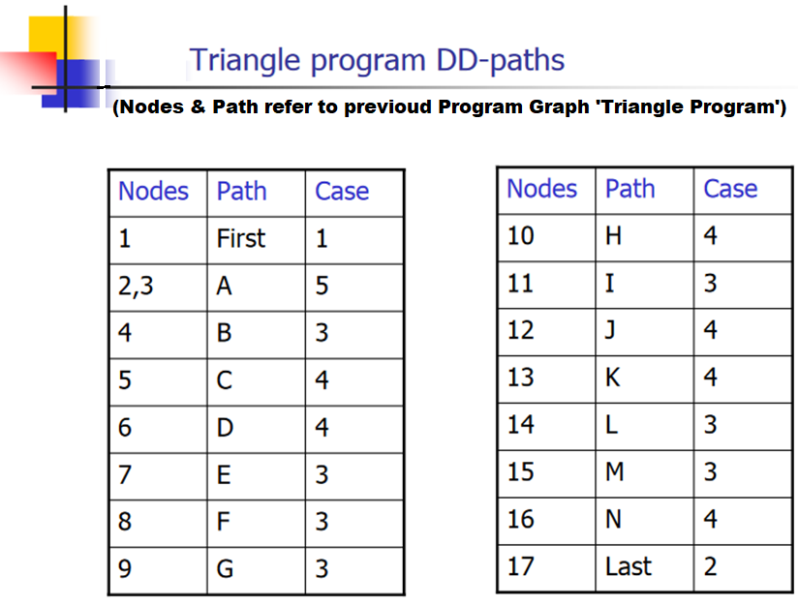

Slide 21
Conclusion for DD-path graph
The DD-path graph is a form of condensation graph, 2-connected components are collapsed into individual nodes (conditional bifurcation) that will form DD-paths.
The single-node DD-paths are required to preserve the concept that “a statement (or statement fragment) is in exactly one DD-path”.
Otherwise it ends up with ambiguous & clumsy DD-path graphs having some statement fragments that lead to several DD-paths.
In practice, it is feasible to create DD-path graphs manually for the programs up to 100 source lines approximately, beyond which testers also look for automated testing tool.
High-quality commercial tools available, that generate the DD-path graph of a given program and also work for a wide variety of programming languages.

Slide 22
Test Coverage : Metrics
The goals & purpose of DD-paths testing is to enable very precise descriptions of test coverage, Which is the functional testing method.
After the closer look into the decision path and specification based testing, it seems that the fundamental limitations is, here impossible to know how far the test cases are redundant.
The functional test will exercise the good-old Venn diagram showing the relation between the specification, programmed and tested behaviors.
Test coverage metrics measure the extent to which the test cases cover the complete program.

Slide 23


Program Graph–Based Coverage Metrics
Definition 1: Given a set of test cases for a program node coverage if, when executed on the program, every node in the program-graph is traversed. Denote this level of coverage G stands for Graph
Definition 2: Given a set of test cases for a program a node may constitute edge coverage. Denote this as
The difference between and is that, in the latter, we are assured that all outcomes of a decision-making statement are executed. For example in our triangle problem all or complete set of if–then–else statements. (the condition test, the true outcome, and the false outcome).
We find a set of test cases such that, when executed, every node of the program graph is traversed at least once.

Slide 24


Program Graph–Based Coverage Metrics
Definition 3: Test cases for a program constitute chain coverage, this chain has length grater than or equal to 2 in program graph. Denote this as
The coverage is same as the node coverage in DD-path graph. Because every decision-to-decision has at-least 2 paths (as aforesaid statement “chain length greater than or equal to 2”).
Definition 4: Given a set of test cases for a program, they constitute path coverage, there exists a path from the source node to the sink node in the program graph is traversed. Denote this level of coverage as .
This coverage is open to severe limitations when there are loops in a program.
Every loop in a program graph represents a set of strongly (3-connected) nodes. (Only during executing loop is exercised for all cycles and is shown in original program graph as directed acyclic graph.)

Slide 25
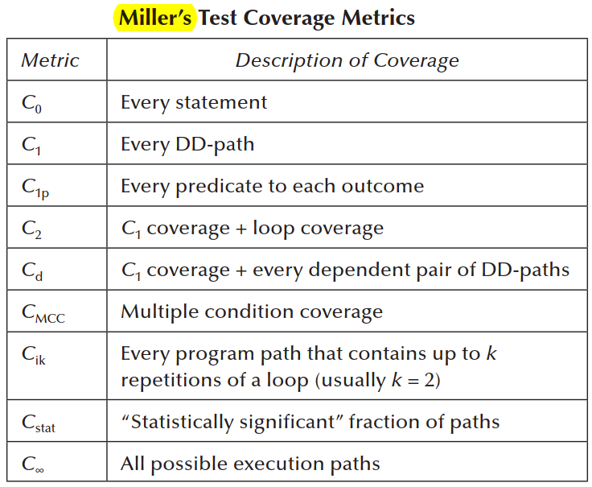
(Miller’s) Test Coverage Metrics
Several test coverage metrics used based on the Miller’s work onwards year 1977.
The following table shows at-least 9 test coverage metrics based on their self-explainatory features.
Most quality organizations now expect the C1 metric (DD-path coverage) as the minimum acceptable level of test coverage.

